Slide 1
CS 401 Weather App
Harischandra, Niesen, Raguay, Ulloa, Vedula

Slide 2
Challenges Faced
Finding a suitable platform for the UI
Issues with CORS and the Same Origin Policy
Google Web Toolkit (GWT) did not pair well with GitHub
Various other technology issues

Slide 3
Calculations
Relative Humidity = (Vapor Pressure / Saturation Vapor Pressure) * 100
Vapor Pressure = 6.112 * exp ((17.67 * DWPC) / (243.50 + DWPC))
SVP = 6.112 * exp ((17.67 * TMPC) / (243.50 + TMPC))
Wind speed = (Winds peed in knots * 1.15077945)
Note: DWPC = Dew Point in Celsius. Temperature = Temperature in Celsius.

Slide 4
Missed Calculations
Precipitation
Cloud Cover
Predicting forecasts up to a week in advance
Comparing weather models within the forecast
Thunderstorm and snowfall forecasts including severe weather potential

Slide 5
Features
Current Weather Reading
http://w1.weather.gov/data/METAR/KORD.1.txt
Predictions up to 3 days
http://www.meteor.iastate.edu/~ckarsten/bufkit/data/nam/nam_kord.buf
Weather History
http://cs.neiu.edu/~nvedula/history.php
Dynamic images based on current weather conditions.

Slide 6
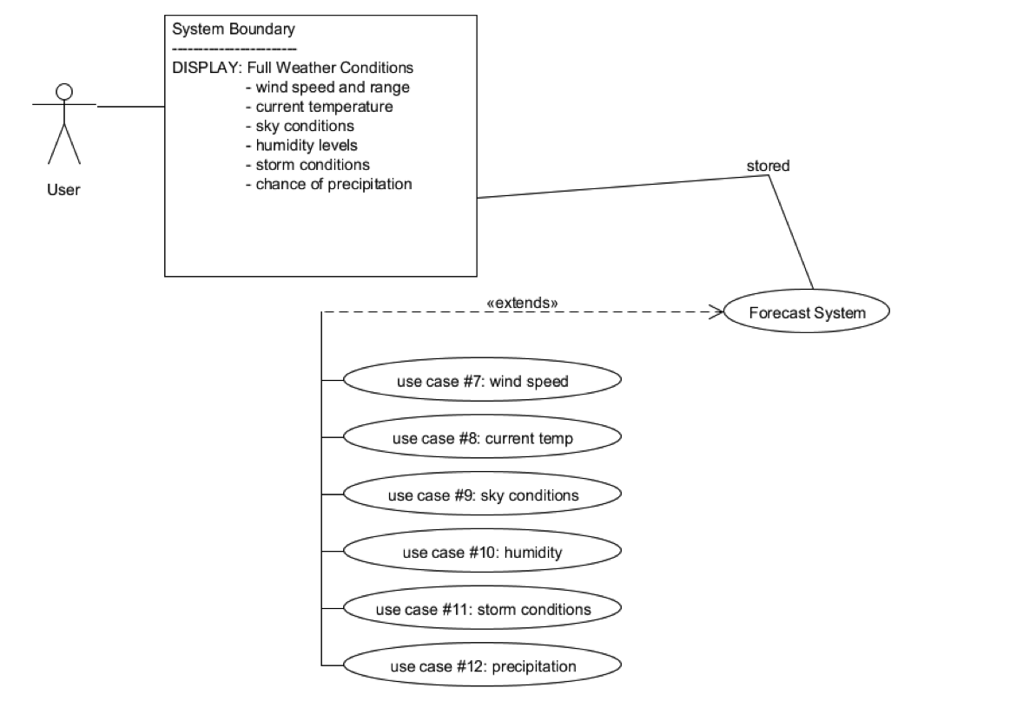
Use Cases

Slide 7
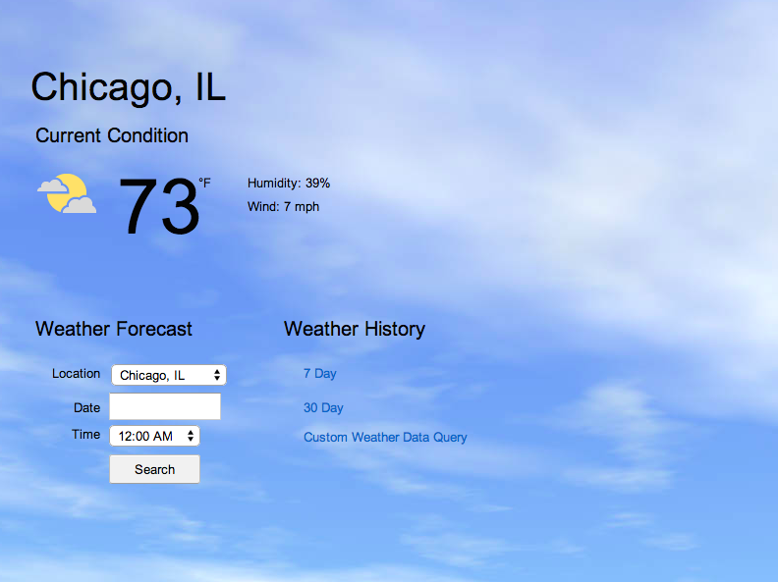

Slide 8
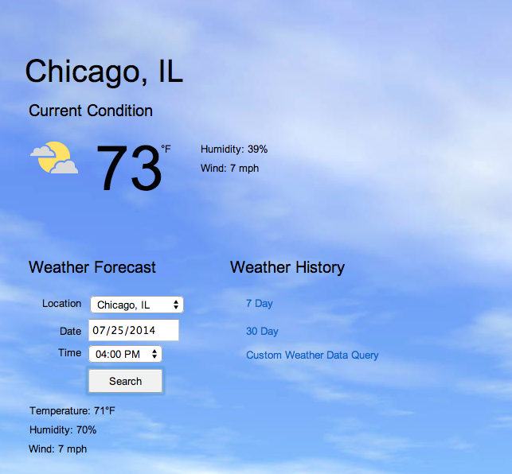

Slide 9
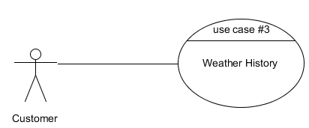

Slide 10
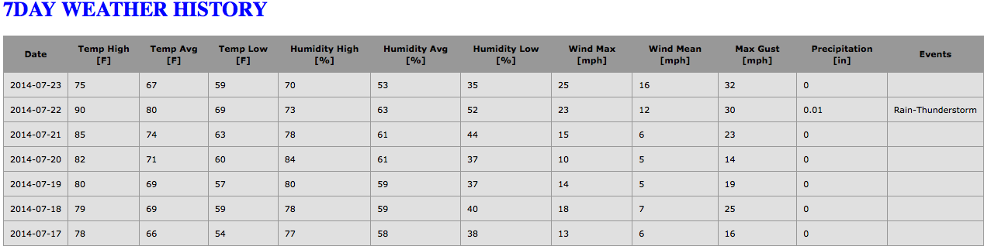

Slide 11
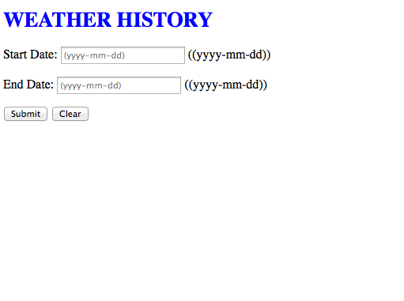

Slide 12
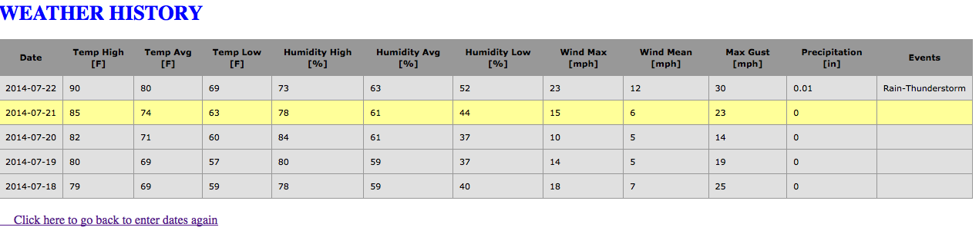

Slide 13
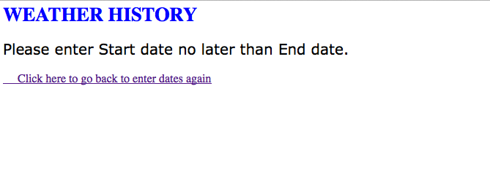

Slide 14
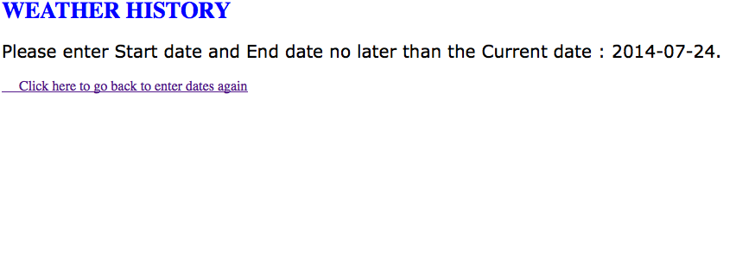

Slide 15
Future Features
Admin Tool
Mobile?
Incorporate missed calculations into weather predictions
Change cities

